Slide 1
EPICS PROJECT
TEAM NAMES:
POOJITA 19L31A0552
YATHESWAR 19L31A0546
CHARAN 19L31A0523
SUHAAS 19L310561

Slide 2
Book your slot
Hurry up!!!
Don’t miss the chance to be a part of our events held in our institute[VIIT]

Slide 3
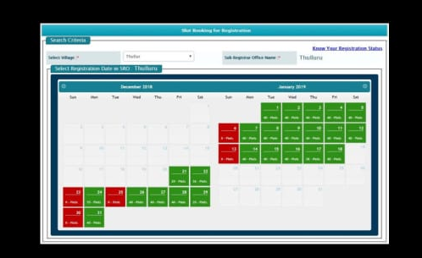
SLOT BOOKING
The online booking has made it possible to be making money even while you and your hotel staff are sleeping. This is one of the reasons the offline booking is going away. Nobody needs to monitor the phone lines, or monitor the email, etc. The booking system takes care of business and accepts payments

Slide 4
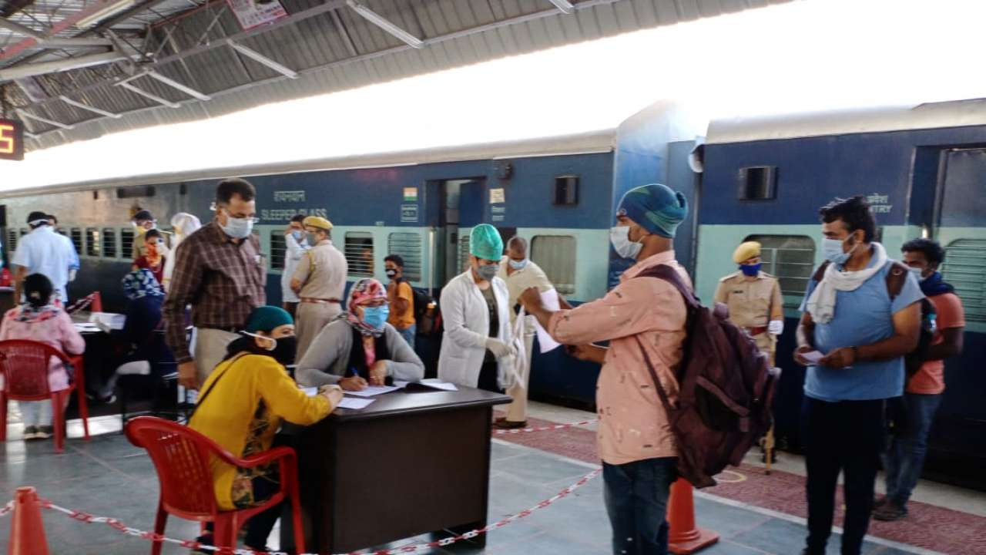
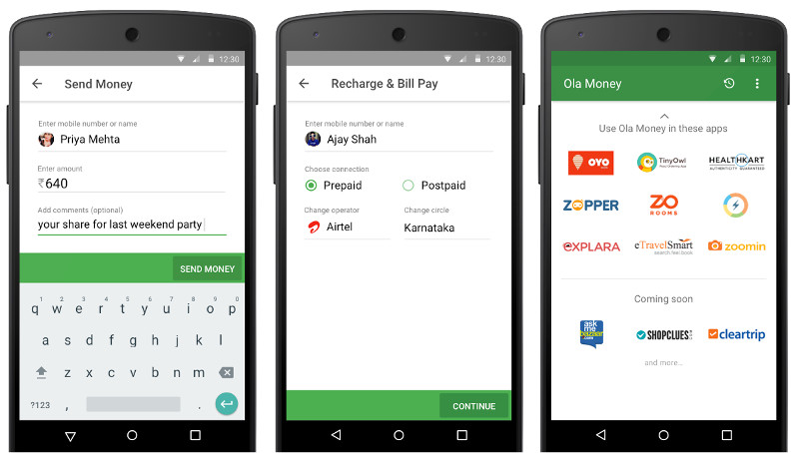
=>Directly book your slot => 24 / 7 customer support
OFFLINE BOOKING
ONLINE BOOKING

Slide 5
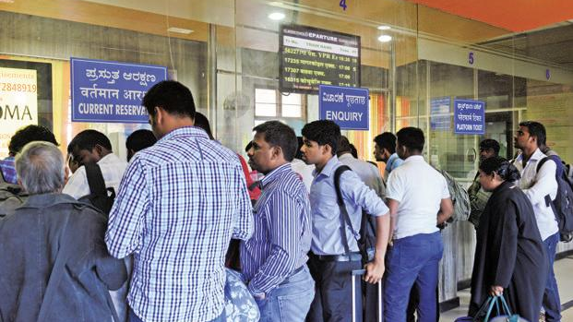
Process for booking your slot:
Click on the link issued
A home page appears.
Click on about for more details.
Gallery appears –(you can check out more info reg faculty members ,event places etc).
Selection of your slots will be done here.
Click on the slot you ae interested to book.
A login page appears.
Login with your name and password as your respective reg numbers.
Event registration is done but confirmation will be in the form of mail from regarding faculty.
When mail is received from respective faculty then your slot is booked successfully.

Slide 6
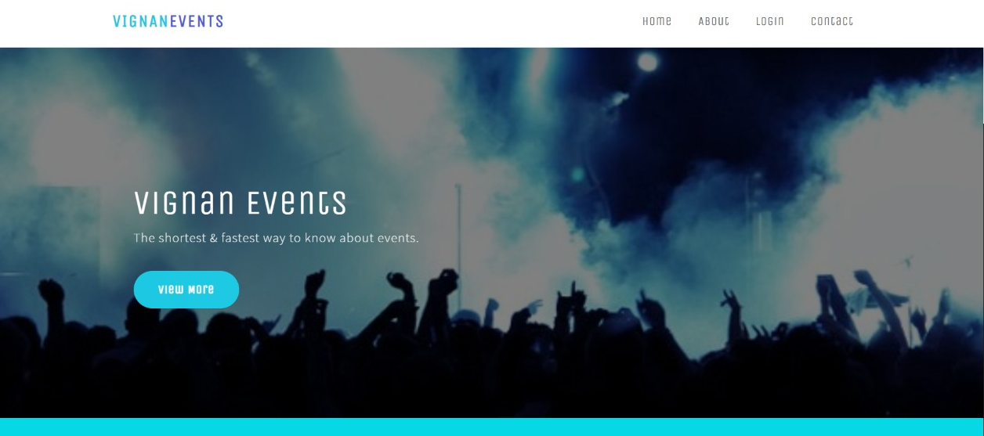
HOME PAGE

Slide 7
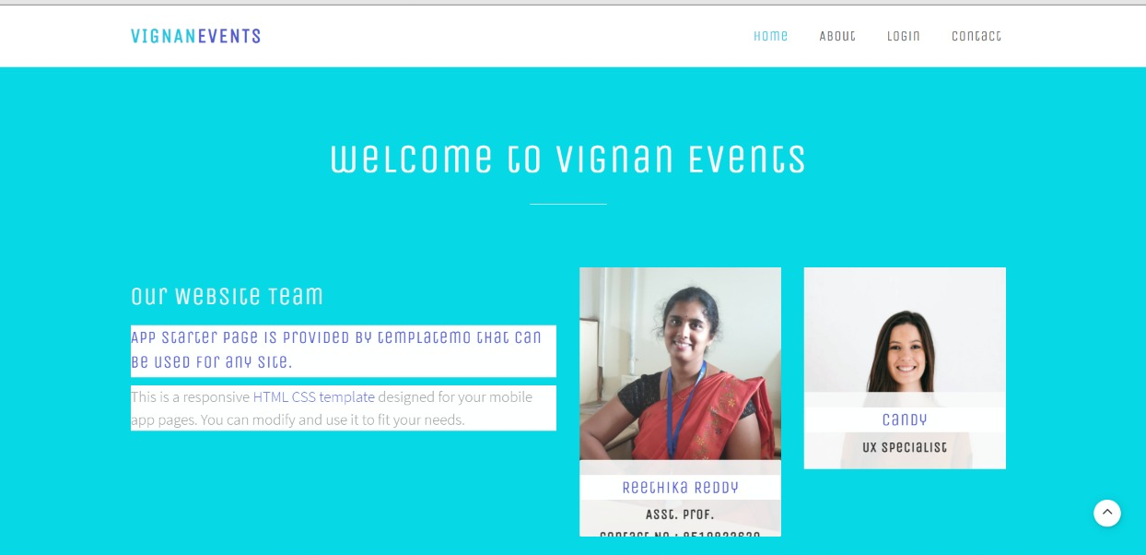
MORE INFO ABOUT FACULTIES

Slide 8
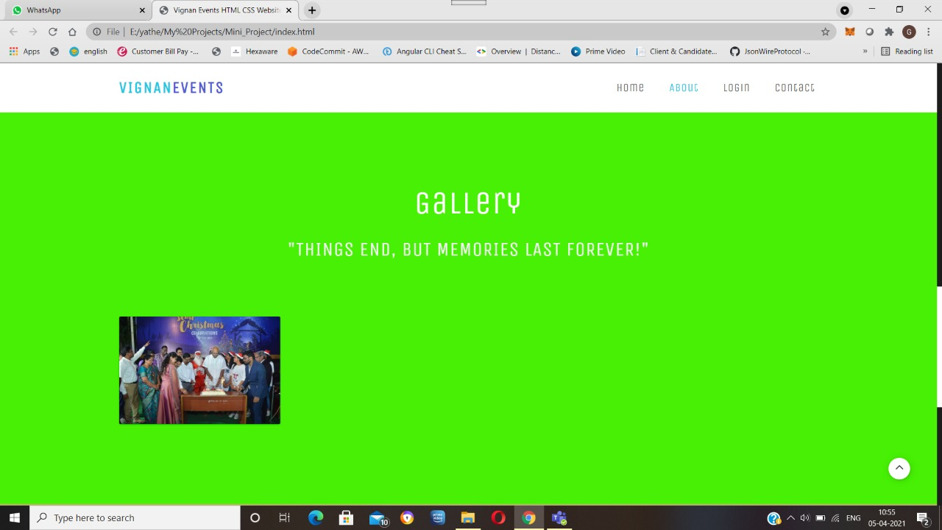
GALLERY OF RECENT EVENTS IN UNIVERSITY

Slide 9
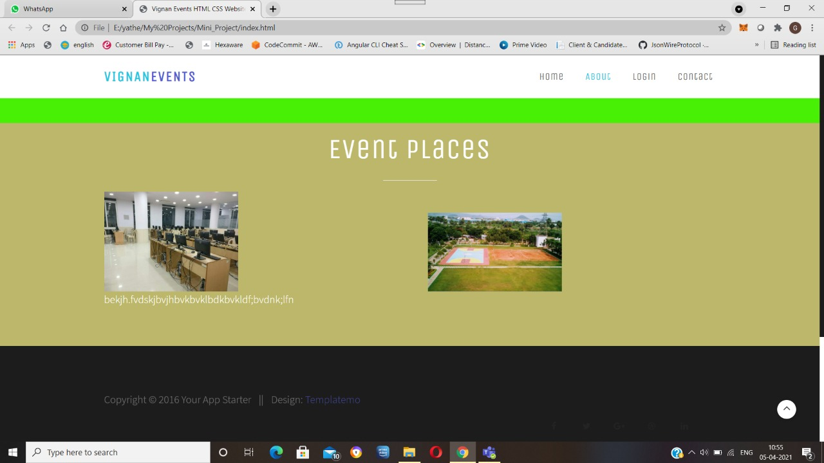
EVENT PLACES FOR BOOKING SLOTS

Slide 10
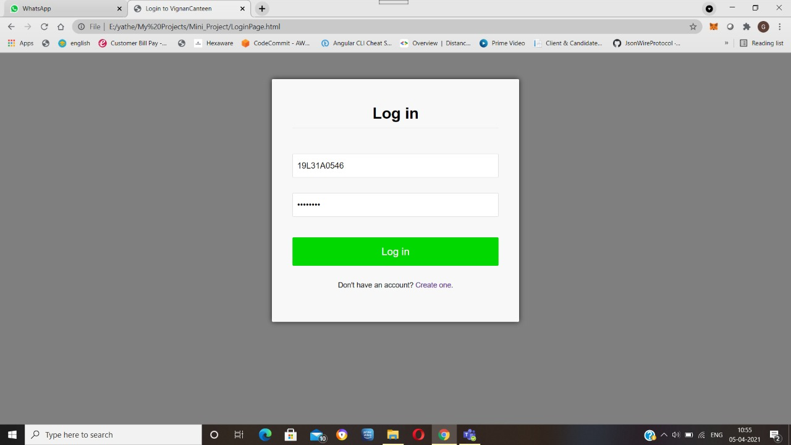
LOGIN PAGE

Slide 11
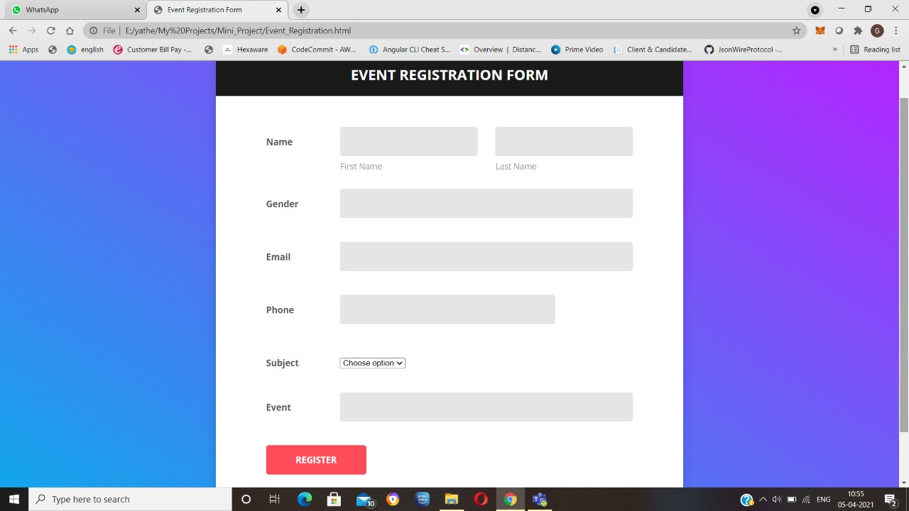
EVENT REGISTRATION FORM PAGE

Slide 12
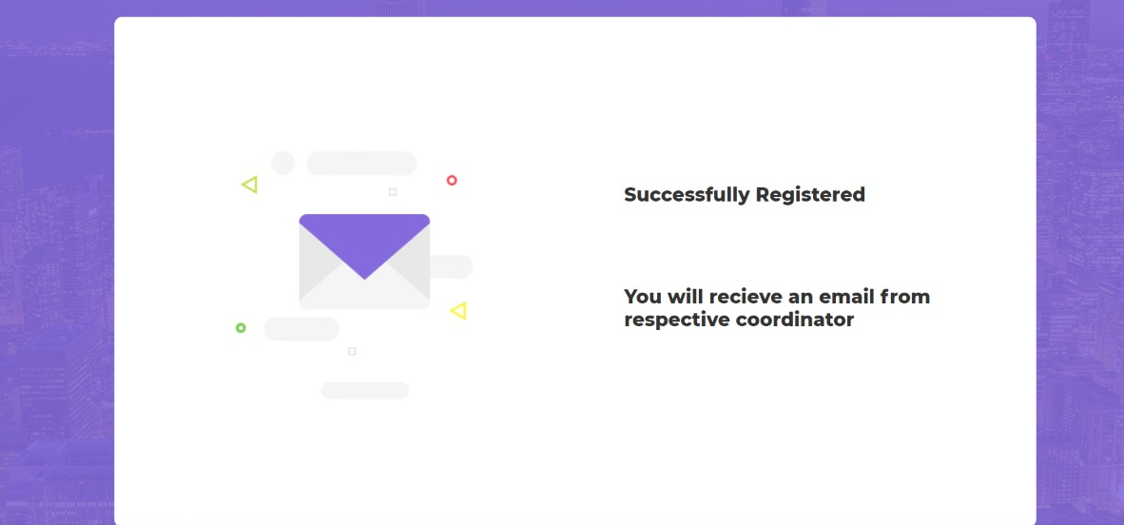
SLOT REGISTERED SUCCESSFULLY

Slide 13
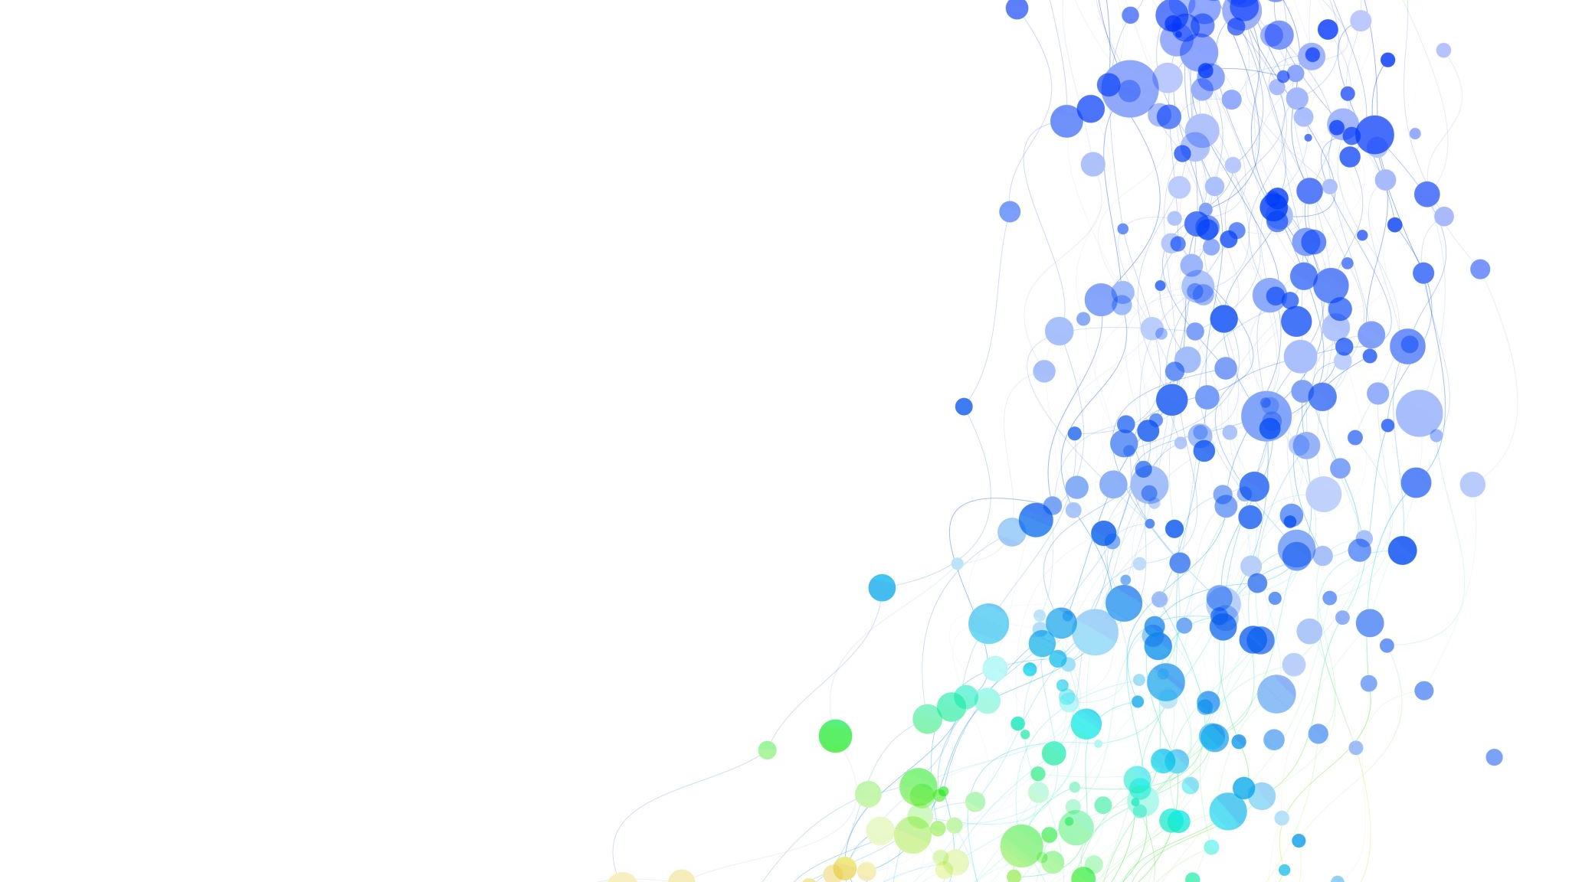
THANK YOU!!

